Slide 1

Basic Models in TensorFlow
CS 20: TensorFlow for Deep Learning Research
Lecture 3
1/19/2017

Slide 3
Agenda
Review
Linear regression on birth/life data
Control Flow
tf.data
Optimizers, gradients
Logistic regression on MNIST
Loss functions

Slide 4
Review
Notes:
Key concepts from the previous two lectures

Slide 5
Computation graph
TensorFlow separates definition of computations from their execution
Phase 1: assemble a graph
Phase 2: use a session to execute operations in the graph.

Slide 6
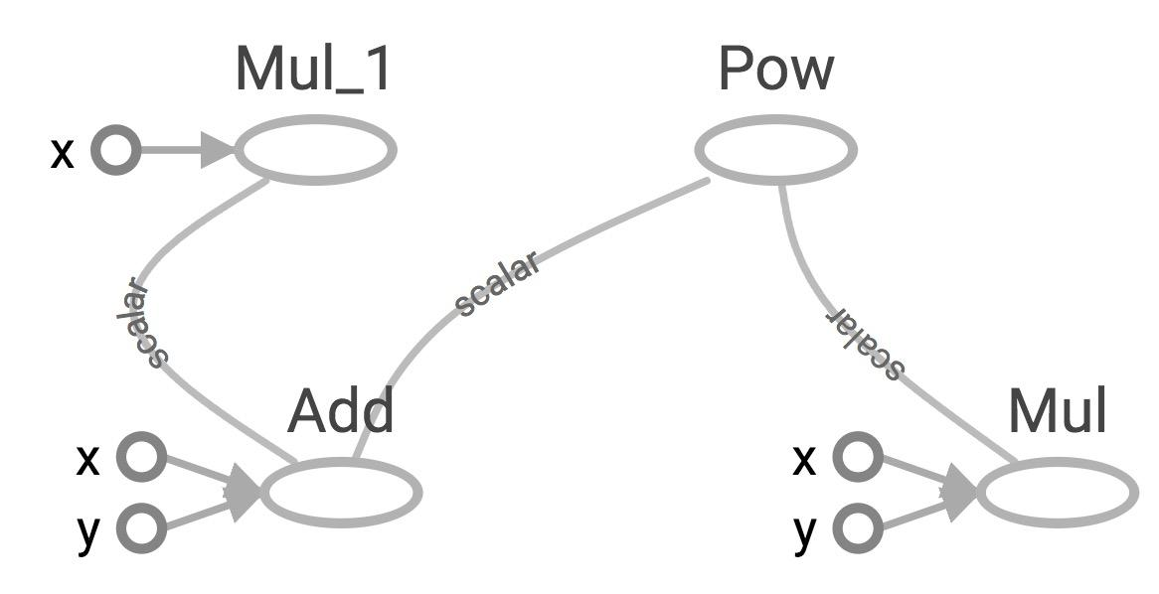
TensorBoard
x = 2 y = 3 add_op = tf.add(x, y) mul_op = tf.multiply(x, y) useless = tf.multiply(x, add_op) pow_op = tf.pow(add_op, mul_op) with tf.Session() as sess: z = sess.run(pow_op)
useless
pow_op
add_op
mul_op
Create a FileWriter object to write your graph to event files

Slide 7
tf.constant and tf.Variable
Constant values are stored in the graph definition
Sessions allocate memory to store variable values

Slide 8
tf.placeholder and feed_dict
Feed values into placeholders with a dictionary (feed_dict)
Easy to use but poor performance

Slide 9
Avoid lazy loading
Separate the assembling of graph and executing ops
Use Python attribute to ensure a function is only loaded the first time it’s called

Slide 10
Download from the class’s GitHub
examples/03_linreg_starter.py
examples/03_logreg_starter.py
examples/utils.py
data/birth_life_2010.txt

Slide 11
Linear Regression
in TensorFlow

Slide 12
Model the linear relationship between:
dependent variable Y
explanatory variables X

Slide 13
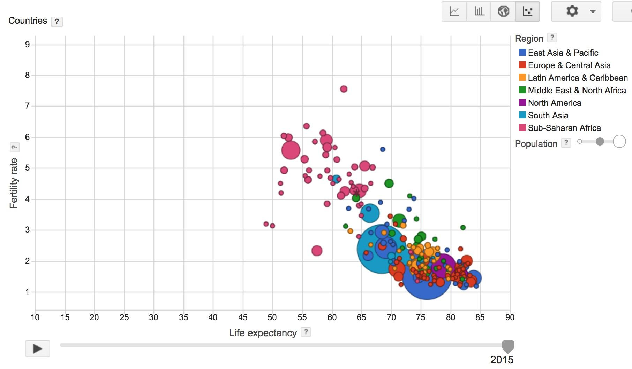
Visualization made by Google, based on data collected by World Bank

Slide 14
World Development Indicators dataset
X: birth rate
Y: life expectancy
190 countries

Slide 15
Want
Find a linear relationship between X and Y
to predict Y from X

Slide 16
Model
Inference: Y_predicted = w * X + b
Mean squared error: E[(y - y_predicted)²]

Slide 17
Interactive Coding
data/birth_life_2010.txt
Notes:
Examine data

Slide 18
Interactive Coding
examples/03_linreg_starter.py

Slide 19
Phase 1: Assemble our graph

Slide 20
Step 1: Read in data
I already did that for you

Slide 21
Step 2: Create placeholders for
inputs and labels
tf.placeholder(dtype, shape=None, name=None)

Slide 22
Step 3: Create weight and bias
tf.get_variable(
name,
shape=None,
dtype=None,
initializer=None,
…
)
No need to specify shape if
using constant initializer

Slide 23
Step 4: Inference
Y_predicted = w * X + b

Slide 24
Step 5: Specify loss function
loss = tf.square(Y - Y_predicted, name='loss')

Slide 25
Step 6: Create optimizer
opt = tf.train.GradientDescentOptimizer(learning_rate=0.001)
optimizer = opt.minimize(loss)

Slide 26
Phase 2: Train our model
Step 1: Initialize variables
Step 2: Run optimizer
(use a feed_dict to feed data into X and Y placeholders)

Slide 27
Write log files using a FileWriter
writer = tf.summary.FileWriter('./graphs/linear_reg', sess.graph)

Slide 28
See it on TensorBoard
Step 1: $ python3 03_linreg_starter.py
Step 2: $ tensorboard --logdir='./graphs'

Slide 29
TypeError?
TypeError: Fetch argument 841.0 has invalid type <class 'numpy.float32'>, must be a string or Tensor.
(Can not convert a float32 into a Tensor or Operation.)

Slide 30
TypeError
for i in range(50): # train the model 100 epochs
total_loss = 0
for x, y in data:
_, loss = sess.run([optimizer, loss], feed_dict={X: x, Y:y}) # Can’t fetch a numpy array
total_loss += loss
Notes:
How does it do so? By using graphs and sessions

Slide 31
TypeError
for i in range(50): # train the model 100 epochs
total_loss = 0
for x, y in data:
_, loss_ = sess.run([optimizer, loss], feed_dict={X: x, Y:y})
total_loss += loss_
Notes:
How does it do so? By using graphs and sessions

Slide 32
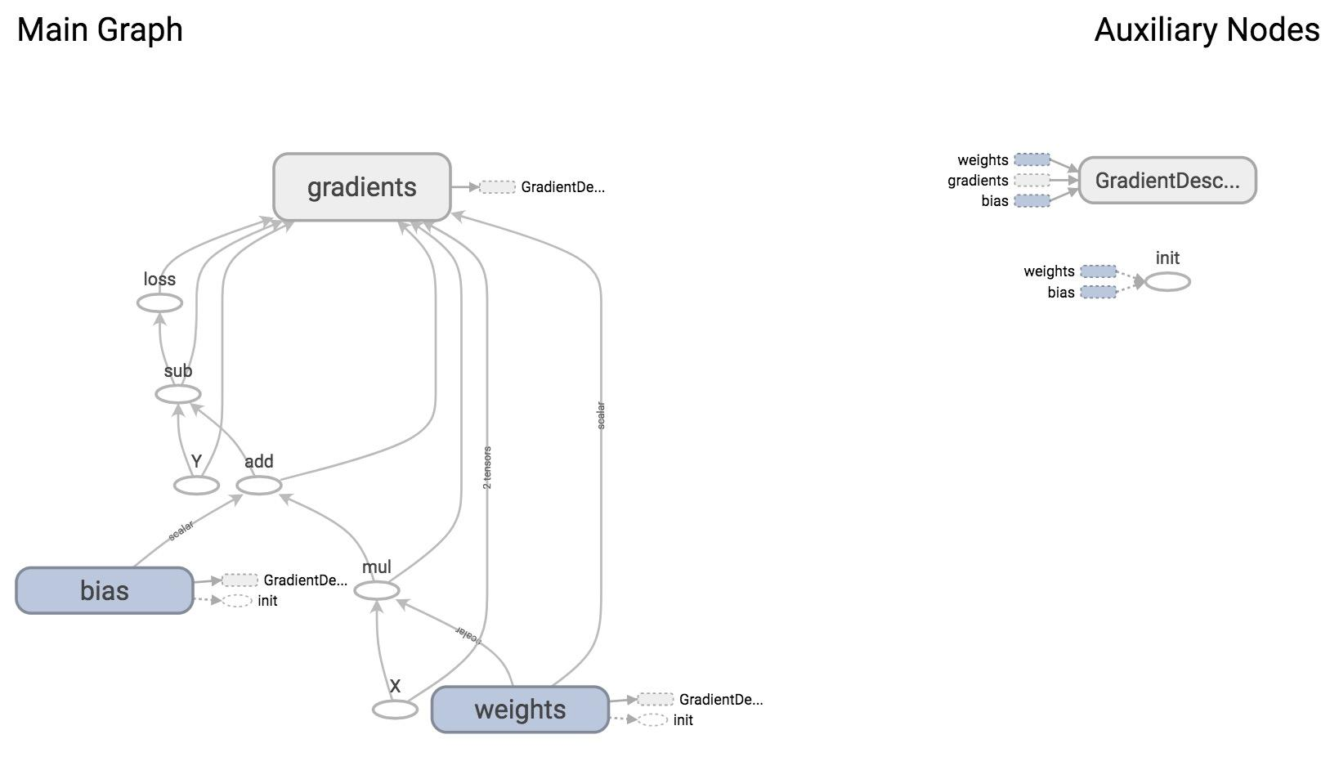

Slide 33
Plot the results with matplotlib
Step 1: Uncomment the plotting code at the end of your program
Step 2: Run it again
If run into problem of matplotlib in virtual environment, go to GitHub/setup and see the file possible setup problems

Slide 34
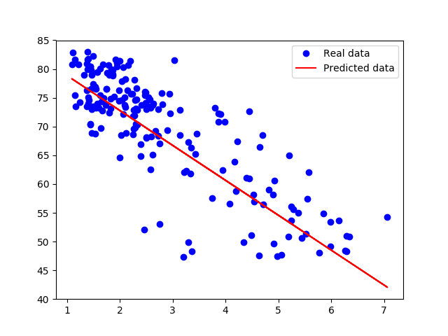

Slide 35
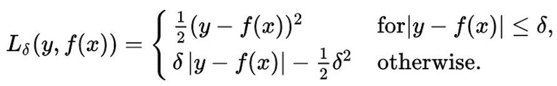
Huber loss
Robust to outliers
If the difference between the predicted value and the real value is small, square it
If it’s large, take its absolute value

Slide 36
Implementing Huber loss
Can’t write:
if y - y_predicted < delta:
You can write it if eager mode were enabled. Stay tuned for the next lecture!

Slide 37
Implementing Huber loss
tf.cond(pred, fn1, fn2, name=None)

Slide 38
Implementing Huber loss
tf.cond(pred, fn1, fn2, name=None)
def huber_loss(labels, predictions, delta=14.0): residual = tf.abs(labels - predictions) def f1(): return 0.5 * tf.square(residual) def f2(): return delta * residual - 0.5 * tf.square(delta) return tf.cond(residual < delta, f1, f2)

Slide 39
TF Control Flow
Control Flow Ops | tf.group, tf.count_up_to, tf.cond, tf.case, tf.while_loop, ...
Comparison Ops | tf.equal, tf.not_equal, tf.less, tf.greater, tf.where, ...
Logical Ops | tf.logical_and, tf.logical_not, tf.logical_or, tf.logical_xor
Debugging Ops | tf.is_finite, tf.is_inf, tf.is_nan, tf.Assert, tf.Print, ...
Since TF builds graph before computation, we have to specify all possible subgraphs beforehand.
PyTorch’s dynamic graphs and TF’s eager execution help overcome this

Slide 40
tf.data

Slide 41
Placeholder
Pro: put the data processing outside TensorFlow, making it easy to do in Python
Cons: users often end up processing their data in a single thread and creating data bottleneck that slows execution down.

Slide 42
Placeholder
data, n_samples = utils.read_birth_life_data(DATA_FILE)
X = tf.placeholder(tf.float32, name='X') Y = tf.placeholder(tf.float32, name='Y') … with tf.Session() as sess: … # Step 8: train the model for i in range(100): # run 100 epochs for x, y in data: # Session runs train_op to minimize loss sess.run(optimizer, feed_dict={X: x, Y:y})

Slide 43
tf.data
Instead of doing inference with placeholders and feeding in data later, do inference directly with data

Slide 44
tf.data
tf.data.Dataset
tf.data.Iterator

Slide 45
Store data in tf.data.Dataset
tf.data.Dataset.from_tensor_slices((features, labels))
tf.data.Dataset.from_generator(gen, output_types, output_shapes)

Slide 46
Store data in tf.data.Dataset
tf.data.Dataset.from_tensor_slices((features, labels))
dataset = tf.data.Dataset.from_tensor_slices((data[:,0], data[:,1]))

Slide 47
Store data in tf.data.Dataset
tf.data.Dataset.from_tensor_slices((features, labels))
dataset = tf.data.Dataset.from_tensor_slices((data[:,0], data[:,1]))
print(dataset.output_types) # >> (tf.float32, tf.float32)
print(dataset.output_shapes) # >> (TensorShape([]), TensorShape([]))

Slide 48
Can also create Dataset from files
tf.data.TextLineDataset(filenames)
tf.data.FixedLengthRecordDataset(filenames)
tf.data.TFRecordDataset(filenames)

Slide 49
tf.data.Iterator
Create an iterator to iterate through samples in Dataset

Slide 50
tf.data.Iterator
iterator = dataset.make_one_shot_iterator()
iterator = dataset.make_initializable_iterator()

Slide 51
tf.data.Iterator
iterator = dataset.make_one_shot_iterator() Iterates through the dataset exactly once. No need to initialization.
iterator = dataset.make_initializable_iterator() Iterates through the dataset as many times as we want. Need to initialize with each epoch.

Slide 52
tf.data.Iterator
iterator = dataset.make_one_shot_iterator() X, Y = iterator.get_next() # X is the birth rate, Y is the life expectancy
with tf.Session() as sess: print(sess.run([X, Y])) # >> [1.822, 74.82825] print(sess.run([X, Y])) # >> [3.869, 70.81949] print(sess.run([X, Y])) # >> [3.911, 72.15066]

Slide 53
tf.data.Iterator
iterator = dataset.make_initializable_iterator()
...
for i in range(100): sess.run(iterator.initializer) total_loss = 0 try: while True: sess.run([optimizer]) except tf.errors.OutOfRangeError: pass

Slide 54
Handling data in TensorFlow
dataset = dataset.shuffle(1000)
dataset = dataset.repeat(100)
dataset = dataset.batch(128)
dataset = dataset.map(lambda x: tf.one_hot(x, 10)) # convert each elem of dataset to one_hot vector

Slide 55
Does tf.data really perform better?
Notes:
s

Slide 56
Does tf.data really perform better?
With placeholder: 9.05271519 seconds
With tf.data: 6.12285947 seconds

Slide 57
Should we always use tf.data?
For prototyping, feed dict can be faster and easier to write (pythonic)
tf.data is tricky 困难的to use when you have complicated preprocessing or multiple data sources
NLP data is normally just a sequence of integers. In this case, transferring the data over to GPU is pretty quick, so the speedup of tf.data isn't that large
处理nlp问题时，是否使用tf.data 在速度上区别不大

Slide 58
How does TensorFlow know what variables to update?
Notes:
s

Slide 59
Optimizers

Slide 60
Optimizer
optimizer = tf.train.GradientDescentOptimizer(learning_rate=0.01).minimize(loss)
_, l = sess.run([optimizer, loss], feed_dict={X: x, Y:y})

Slide 61
Optimizer
optimizer = tf.train.GradientDescentOptimizer(learning_rate=0.001).minimize(loss)
_, l = sess.run([optimizer, loss], feed_dict={X: x, Y:y})
Session looks at all trainable variables that loss depends on and update them

Slide 62
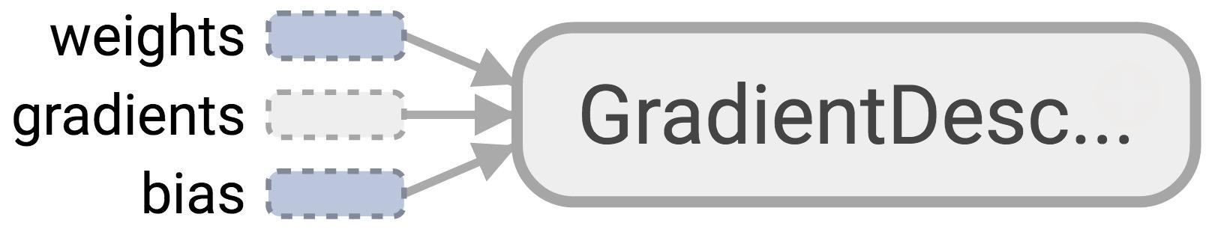
Optimizer
Session looks at all trainable variables that optimizer depends on and update them

Slide 63
Trainable variables
tf.Variable(initial_value=None, trainable=True,...)
Specify if a variable should be trained or not
By default, all variables are trainable
Notes:
For example, global_steps shouldn’t be trainable
Or in double q-learning, you want to alternate which q-value functions to update

Slide 64
List of optimizers in TF
tf.train.GradientDescentOptimizer
tf.train.AdagradOptimizer
tf.train.MomentumOptimizer
tf.train.AdamOptimizer
tf.train.FtrlOptimizer
tf.train.RMSPropOptimizer
...
“Advanced” optimizers work better when tuned, but are generally harder to tune
Notes:
RMSprop, Adagrad, and Adam are very similar algorithms that do well in similar circumstances. Kingma et al. [15] show that its bias-correction helps Adam slightly outperform RMSprop towards the end of optimization as gradients become sparser. Insofar, Adam might be the best overall choice.”

Slide 65
Discussion question
How to know that our model is correct?
How to improve our model?

Slide 66
Assignment 1
Out tomorrow
Due 1/31
Optional Interactive Grading

Slide 67
Logistic Regression
in TensorFlow

Slide 68

Then he separated the light from the darkness
The first logistic regression model

Slide 69
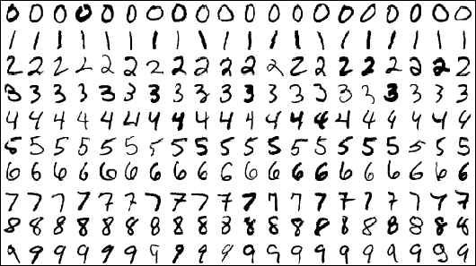
MNIST Database
Each image is a 28x28 array, flattened out to be a 1-d tensor of size 784
Notes:
Hosted on yann.lecun.com/exdb/mnist/

Slide 70
MNIST
X: image of a handwritten digit
Y: the digit value
Recognize the digit in the image

Slide 71
MNIST
X: image of a handwritten digit
Y: the digit value

Slide 72
Model
Inference: Y_predicted = softmax(X * w + b)
Cross entropy loss: -log(Y_predicted)
Notes:
Y are one-hot vectors

Slide 73
Process data
from tensorflow.examples.tutorials.mnist import input_data
MNIST = input_data.read_data_sets('data/mnist', one_hot=True)

Slide 74
Process data
from tensorflow.examples.tutorials.mnist import input_data
MNIST = input_data.read_data_sets('data/mnist', one_hot=True)
MNIST.train: 55,000 examples
MNIST.validation: 5,000 examples
MNIST.test: 10,000 examples

Slide 75
Process data
from tensorflow.examples.tutorials.mnist import input_data
MNIST = input_data.read_data_sets('data/mnist', one_hot=True)
MNIST.train: 55,000 examples
MNIST.validation: 5,000 examples
MNIST.test: 10,000 examples
No immediate way to convert Python generators to tf.data.Dataset

Slide 76
Process data
mnist_folder = 'data/mnist'
utils.download_mnist(mnist_folder)
train, val, test = utils.read_mnist(mnist_folder, flatten=True)

Slide 77
Create datasets
mnist_folder = 'data/mnist'
utils.download_mnist(mnist_folder)
train, val, test = utils.read_mnist(mnist_folder, flatten=True)
train_data = tf.data.Dataset.from_tensor_slices(train) train_data = train_data.shuffle(10000) # optional
test_data = tf.data.Dataset.from_tensor_slices(test)

Slide 78
Create iterator
mnist_folder = 'data/mnist'
utils.download_mnist(mnist_folder)
train, val, test = utils.read_mnist(mnist_folder, flatten=True)
train_data = tf.data.Dataset.from_tensor_slices(train) train_data = train_data.shuffle(10000) # optional
test_data = tf.data.Dataset.from_tensor_slices(test)
iterator = train_data.make_initializable_iterator()

Slide 79
Create iterator
mnist_folder = 'data/mnist'
utils.download_mnist(mnist_folder)
train, val, test = utils.read_mnist(mnist_folder, flatten=True)
train_data = tf.data.Dataset.from_tensor_slices(train) train_data = train_data.shuffle(10000) # optional
test_data = tf.data.Dataset.from_tensor_slices(test)
iterator = train_data.make_initializable_iterator()
img, label = iterator.get_next()
…
Problem?

Slide 80

Create iterator
mnist_folder = 'data/mnist'
utils.download_mnist(mnist_folder)
train, val, test = utils.read_mnist(mnist_folder, flatten=True)
train_data = tf.data.Dataset.from_tensor_slices(train) train_data = train_data.shuffle(10000) # optional
test_data = tf.data.Dataset.from_tensor_slices(test)
iterator = train_data.make_initializable_iterator()
img, label = iterator.get_next()
…
>> Can only do inference with train_data.
>> Need to build another subgraph with another iterator for test_data!!!

Slide 81

Create iterator
mnist_folder = 'data/mnist'
utils.download_mnist(mnist_folder)
train, val, test = utils.read_mnist(mnist_folder, flatten=True)
train_data = tf.data.Dataset.from_tensor_slices(train) train_data = train_data.shuffle(10000) # optional
test_data = tf.data.Dataset.from_tensor_slices(test)
iterator = tf.data.Iterator.from_structure(train_data.output_types,
train_data.output_shapes)
img, label = iterator.get_next()
train_init = iterator.make_initializer(train_data) # initializer for train_data
test_init = iterator.make_initializer(test_data) # initializer for train_data
Notes:
Creating an iterator with different initializers!

Slide 82
Initialize iterator with the dataset you want
with tf.Session() as sess:
...
for i in range(n_epochs):
sess.run(train_init) # use train_init during training loop
try:
while True:
_, l = sess.run([optimizer, loss])
except tf.errors.OutOfRangeError:
pass
Notes:
Creating an iterator with different initializers!

Slide 83
Initialize iterator with the dataset you want
with tf.Session() as sess:
...
for i in range(n_epochs):
sess.run(train_init)
try:
while True:
_, l = sess.run([optimizer, loss])
except tf.errors.OutOfRangeError:
pass
# test the model
sess.run(test_init) # use test_init during testing
try:
while True:
sess.run(accuracy)
except tf.errors.OutOfRangeError:
pass
Notes:
Creating an iterator with different initializers!

Slide 84
Phase 1: Assemble our graph

Slide 85
Step 1: Read in data
I already did that for you

Slide 86
Step 2: Create datasets and iterator
train_data = tf.data.Dataset.from_tensor_slices(train) train_data = train_data.shuffle(10000) # optional train_data = train_data.batch(batch_size)
test_data = tf.data.Dataset.from_tensor_slices(test) test_data = test_data.batch(batch_size)

Slide 87
Step 2: Create datasets and iterator
iterator = tf.data.Iterator.from_structure(train_data.output_types, train_data.output_shapes) img, label = iterator.get_next()
train_init = iterator.make_initializer(train_data) test_init = iterator.make_initializer(test_data)

Slide 88
Step 3: Create weights and biases
use tf.get_variable()

Slide 89
Step 4: Build model to predict Y
logits = tf.matmul(img, w) + b
We don’t do softmax here, as we’ll do softmax together with cross_entropy loss.
It’s more efficient to compute gradients w.r.t. logits than w.r.t. softmax

Slide 90
Step 5: Specify loss function
entropy = tf.nn.softmax_cross_entropy_with_logits(labels=label, logits=logits)
loss = tf.reduce_mean(entropy)

Slide 91
Step 6: Create optimizer
tf.train.AdamOptimizer(learning_rate=0.01).minimize(loss)

Slide 92
Phase 2: Train our model
Step 1: Initialize variables
Step 2: Run optimizer op

Slide 93
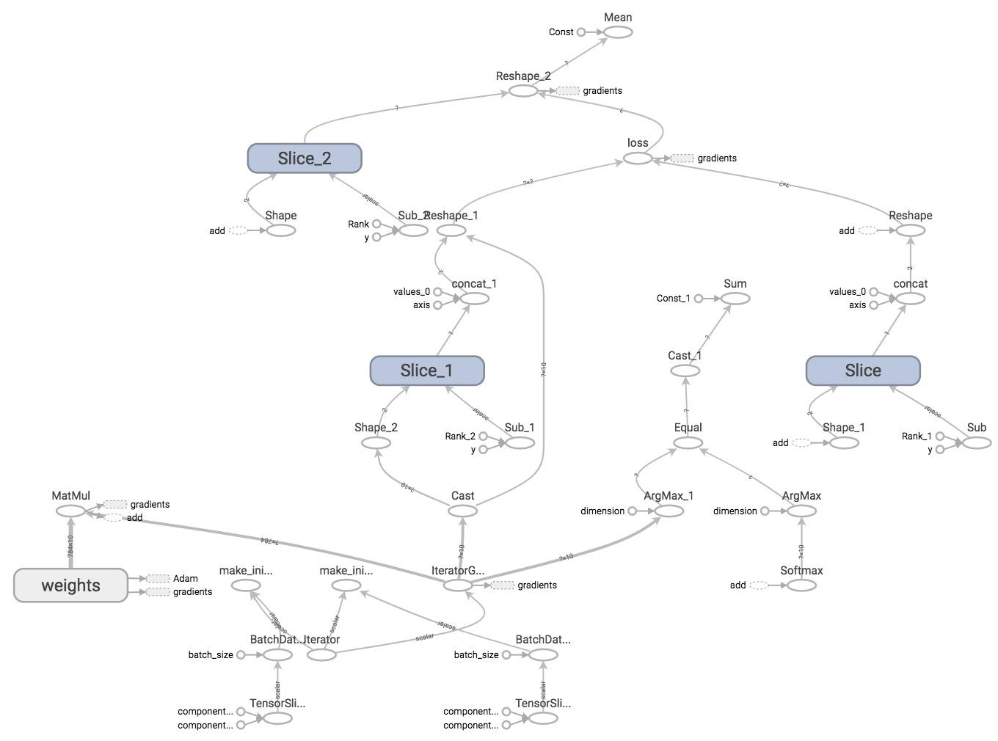
TensorBoard it

Slide 94
Next class
Structure your model in TensorFlow
Example: word2vec
Eager execution
Feedback: huyenn@stanford.edu
Thanks!

